Slide 1
MANDIZVIDZA EUGINE. K. B231791B MUDZINGWA BLESSED B231058B CHIWARA MARGRET B1231754
PRACTICAL Design Participatory Extension approach in Food and Agricultural Programmes
Extension Programmes and Socio-Economic Change

Slide 2
Participatory extension approaches in food and agricultural programs involve engaging and involving farmers, stakeholders, and communities in the process of designing, implementing, and evaluating agricultural extension activities.

Slide 3
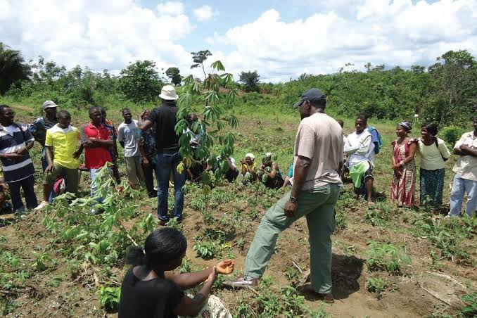

Slide 4
FALL ARMY WORM FARMER FIELD SCHOOL
The FFS approach represents a radical departure from earlier agricultural extension programmes, in which farmers were expected to adopt generalised recommendations that had been formulated by specialists from outside the community. The basic features of a typical rice IPM Farmer Field School are as follows (from Pontius, Dilts, and Bartlett, 2002; Bijlmakers, 2005):
The IPM FFS is field-based and lasts for a full cropping season.
A FFS meets once a week with a total number of meetings that might range from at least 10 (up to 16) meetings.
The primary learning material at a FFS is the cropping field.
The FFS meeting place is close to the learning plots, often in a farmer’s home and sometimes beneath a tree.
FFS educational methods are experiential, participatory, and learner centred.

Slide 5
Each FFS meeting includes at least three activities: the agro-ecosystem analysis, a ‘special topic’, and a group dynamics activity.
In every FFS, participants conduct a study comparing plots with different managements.
An FFS often includes several additional field studies depending on local field problems.
Between 25 and 30 farmers participate in an FFS. Participants learn together in small groups of five to maximise participation.
All FFSs include a ‘field day’ in which farmers make presentations the results of their studies.
A pre- and post-test is conducted as part of every FFS for diagnostic purposes and for determining follow-up activities.
The facilitators of FFSs undergo intensive season-long residential training to prepare them for organising and conducting FFS.
Preparation meetings precede an FFS to determine needs, recruit participants, and develop a learning contract.
Final meetings of the FFS often include planning for follow-up activities.

Slide 6
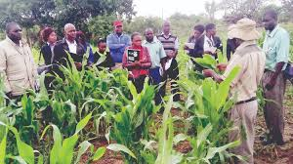

Slide 7
Key principles and strategies for designing participatory extension approaches in food and agricultural programs:
PARTICIPATORY APPROACH DESIGN

Slide 8
Needs Assessment: Begin by conducting a thorough needs assessment to understand the speciﬁc challenges, aspirations, and priorities of the target farmers and communities. This can be achieved through surveys, focus group discussions, interviews, and direct observation.
Farmer Participation: Involve farmers and community members from the outset. Include them in planning, implementation, and evaluation activities. Encourage their active participation by soliciting their opinions, ideas, and feedback throughout the process.
Farmer Field Schools (FFS): FFS is a popular participatory approach where farmers learn by doing. It involves organizing groups of farmers who meet regularly to learn and experiment with new agricultural techniques. Farmers actively participate in decision-making, problem-solving, and knowledge sharing within the group.

Slide 9
Participatory Research and Demonstration: Collaborate with farmers to identify research questions and carry out on-farm trials and demonstrations. Farmers can actively participate in data collection, analysis, and interpretation of results. This enhances their understanding and ownership of the agricultural practices being promoted. Knowledge Sharing Platforms: Establish knowledge-sharing platforms such as farmer groups, cooperatives, or online communities where farmers can exchange experiences, innovations, and best practices. Encourage peer-to-peer learning and facilitate interactions between farmers, extension agents, researchers, and other stakeholders. Capacity Building: Provide training and capacity building activities to enhance farmers' knowledge, skills, and conﬁdence. Offer both formal and informal learning opportunities, including workshops, ﬁeld

Slide 10
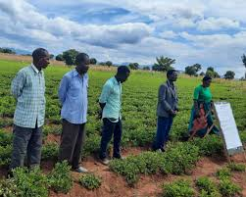

Slide 11
Conclusively, the design principles and strategies aim to effectively empower farmers, promote local innovation, and contribute to sustainable agricultural development.

Slide 12
Extension programs play a crucial role in promoting socio-economic change in communities and societies. These programs are designed to provide education, training, and support to individuals, groups, and communities, with the aim of improving their livelihoods and overall well-being. Here are some key notes on extension programs and their impact on socio-economic change:
EXTENSION PROGRAMMES AND SOCIO-ECONOMIC CHANGE

Slide 13
Agricultural Development: Agricultural extension programs are particularly vital in promoting socioeconomic change in rural areas.
They provide farmers with up-to-date information on modern farming techniques, crop varieties, pest management strategies, and market trends. By adopting these practices, farmers can increase their yields, reduce production costs, and enhance their income.
Rural Development: Extension programs extend beyond agriculture to encompass rural development initiatives.
They address various aspects such as infrastructure development, access to clean water and sanitation, renewable energy, and microfinance. By improving rural infrastructure and services, these programs contribute to poverty reduction and enhance the overall socio-economic conditions of rural communities.

Slide 14
Health and Nutrition: Some extension programs focus on health and nutrition education. They provide communities with information on disease prevention, hygiene practices, maternal and child health, and nutrition. By improving health outcomes and reducing healthcare costs, these programs contribute to overall socio-economic development.
Women Empowerment: Extension programs often prioritize the empowerment of women, recognizing their crucial role in socio-economic development. These programs provide training on gender equality, women's rights, and income-generating activities. By empowering women, extension programs promote inclusive growth and foster more equitable societies.
Community Engagement and Participation: Extension programs emphasize community engagement and participation. They involve community members in program planning, implementation, and evaluation. This participatory approach ensures that programs address the specific needs of the community, promoting ownership, and sustainability.

Slide 15
In a nut shell, extension programs are powerful tools for driving socio-economic change. By providing knowledge, skills, and support, they empower individuals and communities to enhance their livelihoods, reduce poverty, and achieve sustainable development.

Slide 16
REFERENCE
Bartlett A. (2005) Farmer Field Schools to promote Integrated Pest Management in Asia: the FAO experience, Workshop on Scaling Up Case Studies in Agriculture. IRRI.
Bijlmakers, H.( 2005) Farmer Field Schools for IPM - Refresh your Memory, IPM DANIDA
Feder, G., R. Murgai, and J. B. Quizon (2004b) 'The acquisition and diffusion of knowledge: The case of pest management training in farmer field schools, Indonesia'. Journal of Agricultural Economics 55, no. 2 (2004b): 221-43.
Pontius, J., R. Dilts, , A. Bartlett (2002) Ten Years of IPM Training in Asia - From Farmer Field School to Community IPM, FAO

